Slide 1
Date-a-Scientist Final Project
Machine Learning Fundamentals
Travis Dantzer
June 5th, 2019

Slide 2
Overview
Initial Exploration of Dataset
Augmenting the Dataset
Classification Approaches
Regression Approaches
Conclusions

Slide 3
Initial Exploration
Demographics
Data Representation

Slide 4
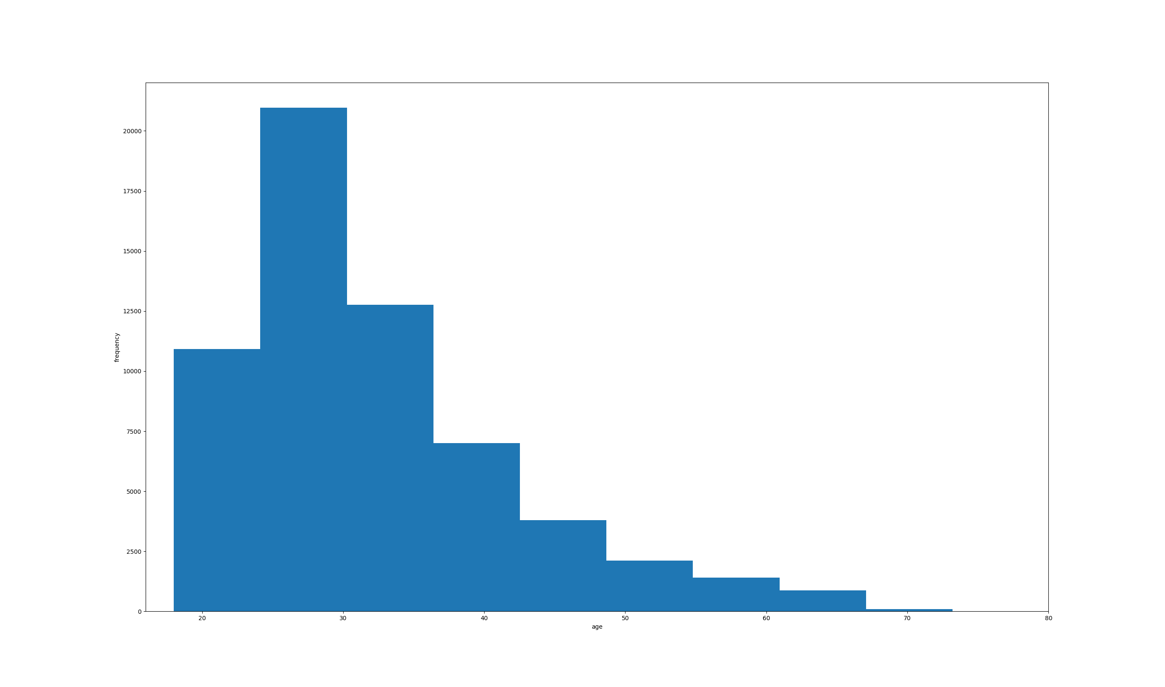
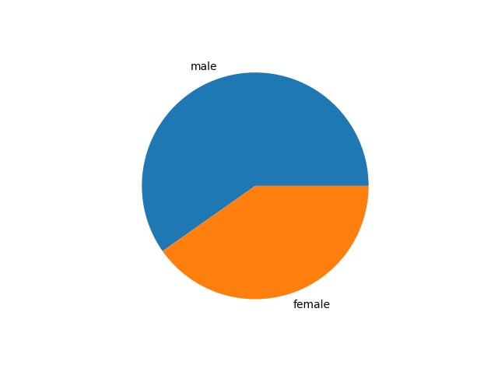
Demographics
Age
Sex

Slide 5
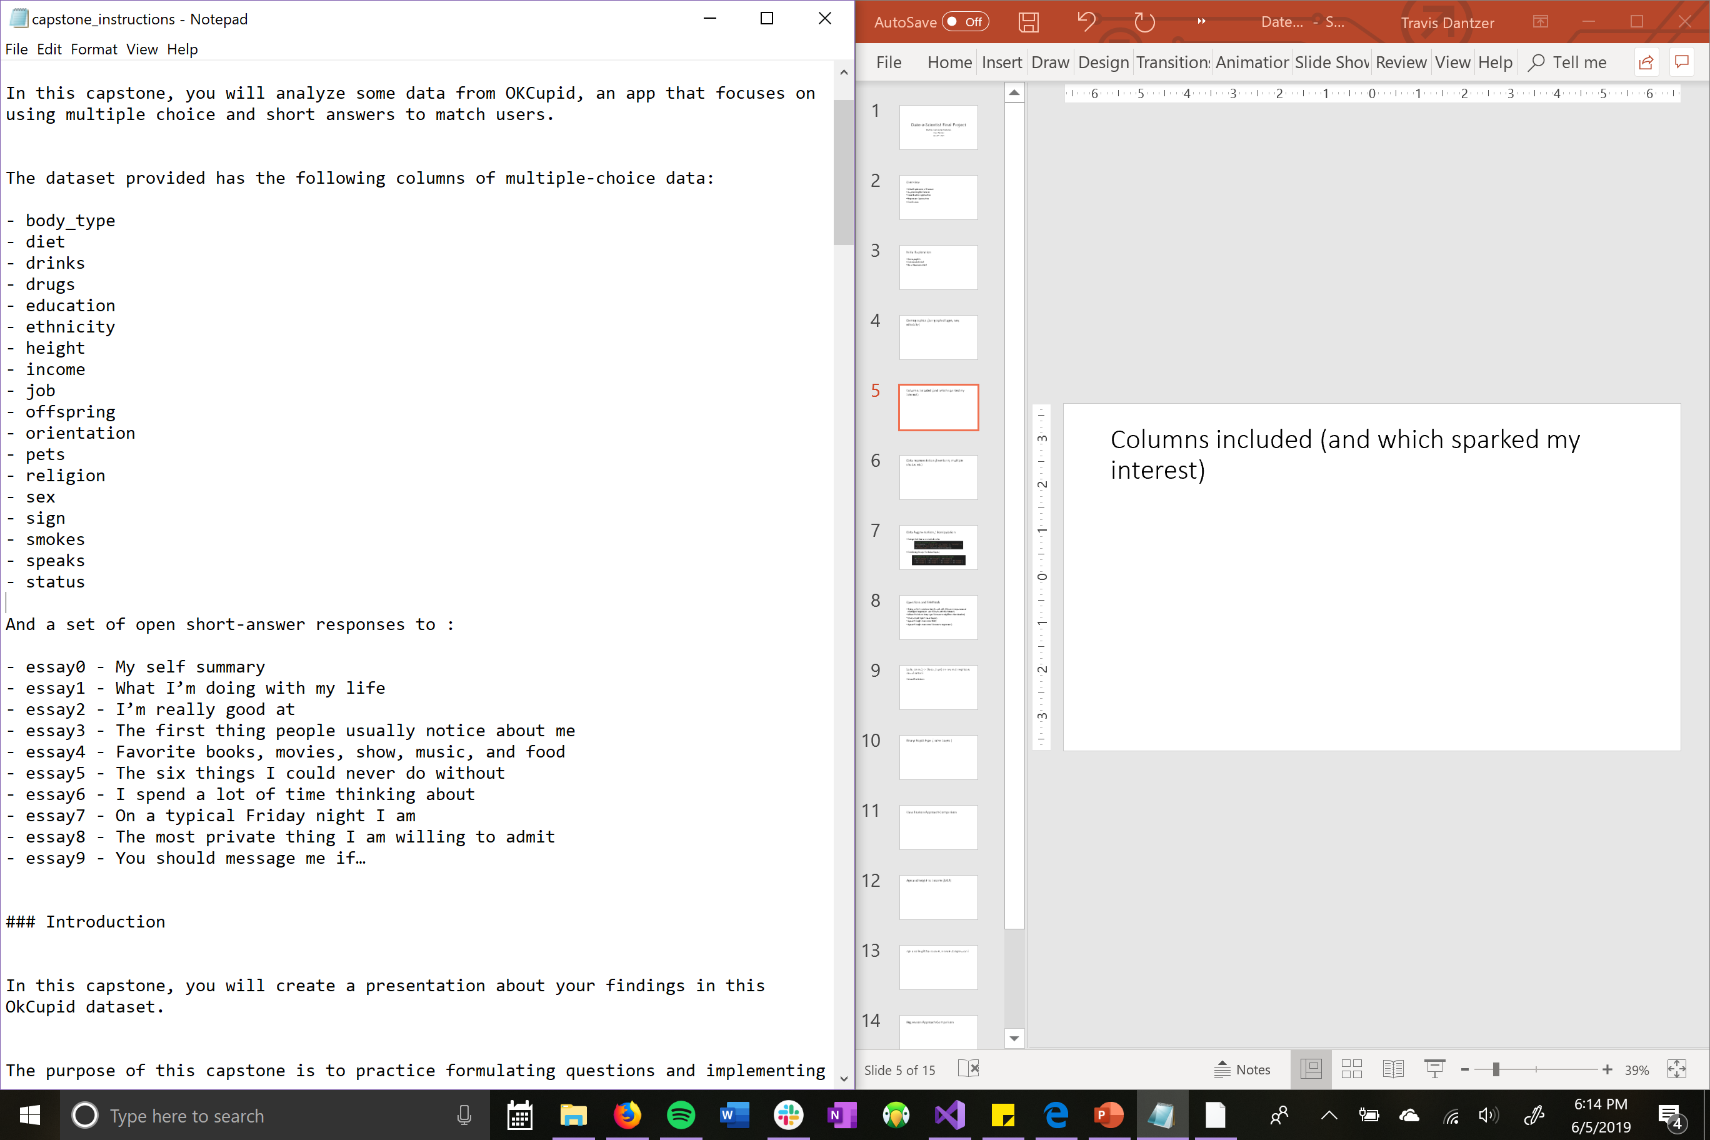
Data Representation

Slide 6
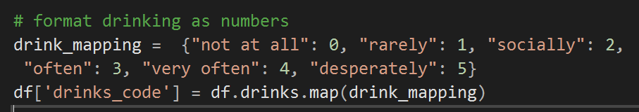
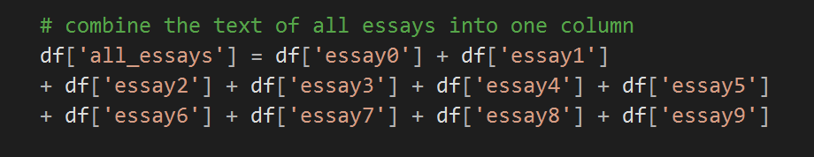
Data Augmentation / Manipulation
Categorical data to numerical codes
Combining Essays (for Naïve Bayes)

Slide 7
Questions and Methods
I tried to find questions that fit well with different computational strategies (regression was difficult with this dataset)
Job and drinks to body type ( k-nearest neighbors classification)
Essays to job type ( naïve bayes )
Age and height to income (MLR)
Age and height to income ( k-nearest regression )

Slide 8
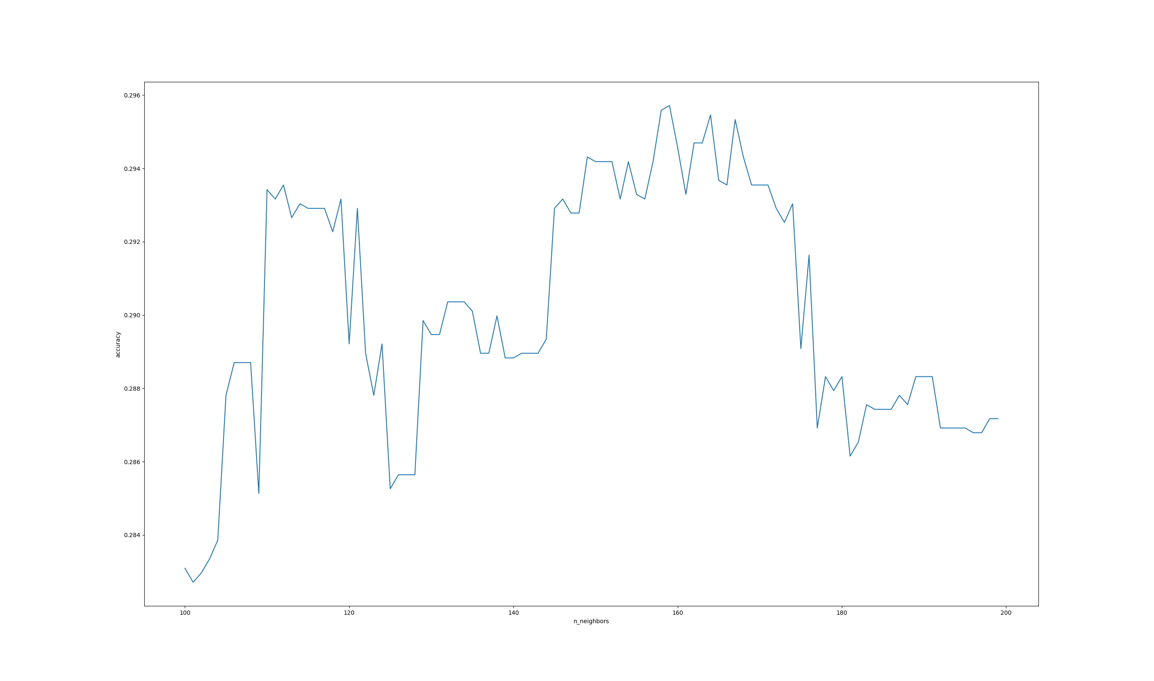
k-nearest neighbors classification
This model attempted to predict body type by occupation field and drinking habits
Optimum number of neighbors was 160
29.457% mean accuracy achieved
Not extremely predictive, but
better than I expected
Selecting the number of neighbors

Slide 9
Naïve Bayes Classification
This model analyzed the text of a profile’s essays and attempted to predict the person’s occupation
Achieved 40.5% mean accuracy

Slide 10
Classification Approach Comparison
K-Nearest required tuning of neighbor numbers (quite expensive computationally so lots of waiting around)
Naïve bayes was far less lines of code

Slide 11
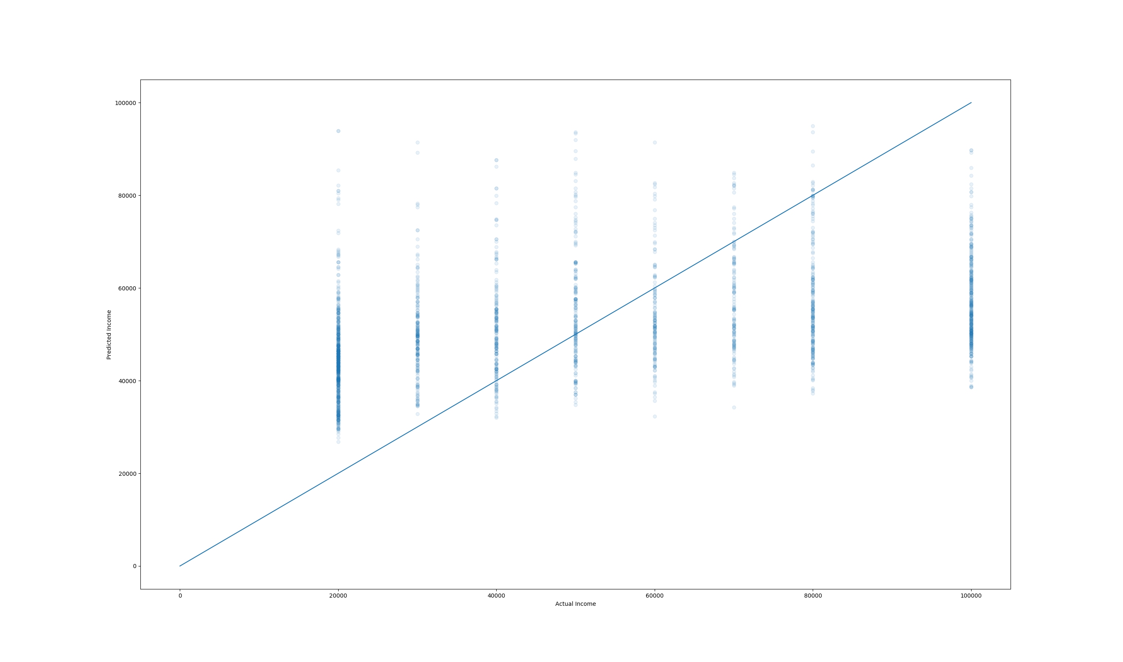
Multiple Linear Regression
This model attempted to correlate age, height, and sex with income
R^2 coefficient of determination = 0.167 (not strong)
Coefficient weights:
[age: 1098.58401239 height: 271.22343081 sex: 8870.42335571]
Predicted and Actual Income

Slide 12
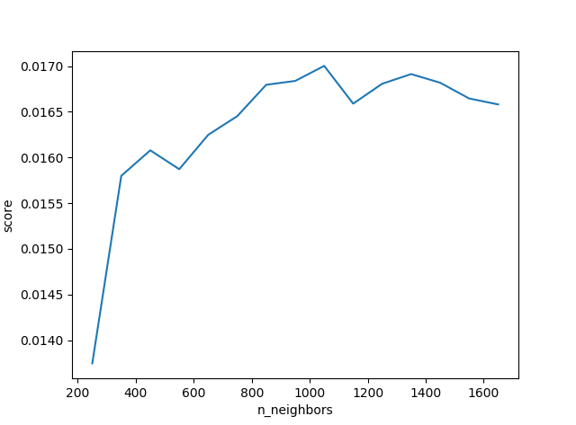
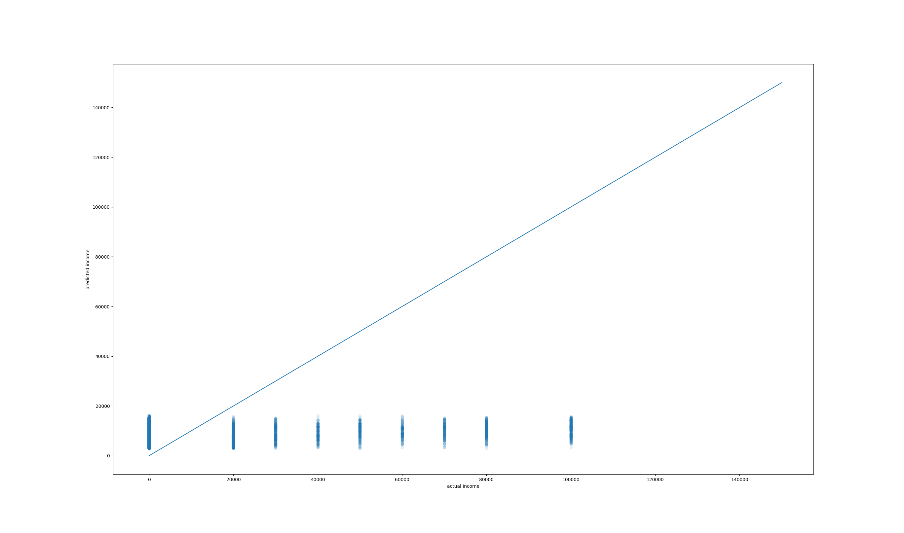
K-Nearest Neighbors Regression
This model attempted to relate age and height to income
R^2 coefficient of determination = 0.016940736811577706
Very little predictive ability
Predicted and Actual Incomes
Neighbor Number Selection

Slide 13
Regression Approach Comparison
Multiple Linear Regression seemed to work much better and was easier to implement
K-Nearest again required tuning of the number of neighbors

Slide 14
Conclusions
I was most impressed by the Naive Bayes Classifier being able to correctly classify a person’s profession nearly half the time from what was mostly personal (i.e. not professional) information.
The dataset did not lend itself to regression as only a few categories made sense to order as strictly increasing (age, height) and some that did weren’t continuous (drinking, drugs, etc)

